Slide 1
Business Intelligence
Lecture 1

Slide 2
About Me Current
(in progress) Ph.D in Information/Data Science
Lecturer / Researcher – Probabilistic models, Massive data methodologies, Music technology and collaborative platforms
Past
BS.c in Computer Science (learning environments and algorithms)
MS.c in Computer Science (collaborative platforms and science education)
Full stack software engineer

Slide 3
Logistics:
3 weekly hours
Assignments (30%), Project (70%)
Communication through Moodle / Email
Weekly reception hour
Email - or.izhakp@afeka.ac.il

Slide 4
What You Are Getting
Describe the concepts and components of business Intelligence.
Use of BI for supporting decision making in an organization.
Understand and use the technologies and tools that make up BI:
Data warehousing
Data reporting
Analytics
4. Build, manage and maintenance of data-driven project.

Slide 5
What You Are Giving
Four assignments (groups of 2-4 members)
BI developers / analysts always work as a team!
Final project
Class participation
Smiles and fun ☺

Slide 6
Ready?

Slide 7
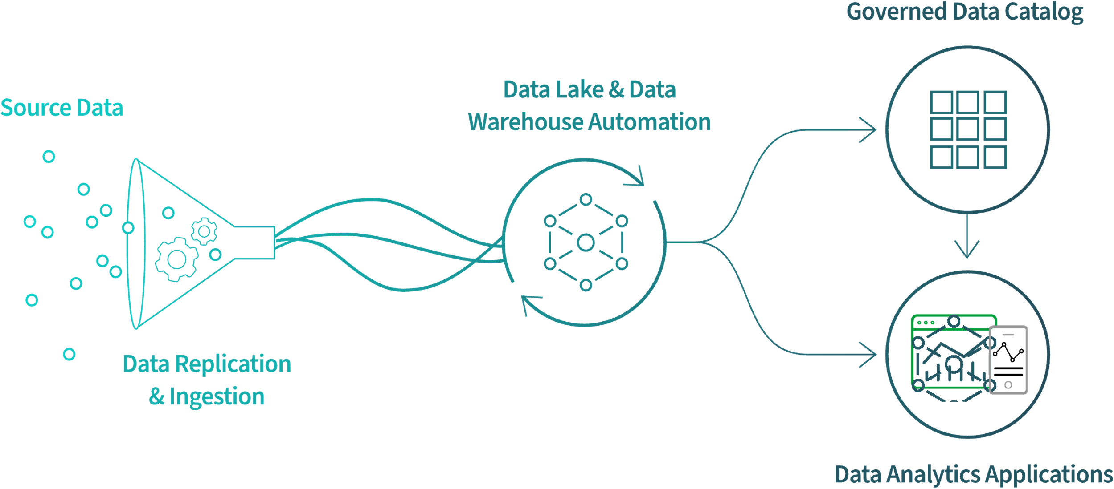
Introduction
Business Intelligence (BI) is a set of ideas, methodologies, processes, architectures, and technologies that change raw data into significant and useful data for business purpose.

Slide 8
Introduction
Benefits:
Can handle large amounts of data to help identify and evolve new opportunities.
Making use of these new opportunities and applying a productive scheme.
Provide a comparable market benefit and long-term stability.
Use the technology as a tool!

Slide 9

Example
Suppose we have company data of 3-6 months. Assume that we have candles product. We have three kinds of candles in this class say Candle A, Candle B, Candle C.
On studying the data we come to know that sale of candle C was at peak out of these three classes, and the sale was maximum between the time intervals of 9 am to 11 am.

Slide 10
Example
Now, let’s apply Business Intelligence for this analysis.
What the organization can do?
Get other material that can be used in church and place them nearby those candles.
Enhance the sales
Enhance the income
May help customers to find other relative products

Slide 11
Data
Data - raw facts that describe the characteristics of an event or object
StudentID | Name | Credit | GPA
42271 | Ross | 77 | 2.96
65655 | Rachel | 43 | 2.34
44311 | Monica | 65 | 3.14
72313 | Chandler | 56 | 3.81
63223 | Joey | 44 | 2.98

Slide 12
Data
Information – data converted into a meaningful insights
Knowledge – the skills and experience coupled with information and intelligence, that creates a person’s intellectual resources.
Raw Data
51,77,58,82,64,70
Context
Test scores achieved by students
Information
The average test score is 67

Slide 13
Data to Wisdom
Wisdom
Knowledge
Information
Data
I better stop the car!
Applied
Context
The traffic light has turned red
Meaning
Traffic lights on the main street
Raw
Red, 192, 235, V2

Slide 14
Business Analytics, BI, Big Data, Data Mining - What’s the difference?
Business Analytics
Tools to explore past data to gain insight into future business decisions.
BI
Tools and techniques to turn data into meaningful information.
Big Data
data sets that are so large or complex that traditional data processing applications are inadequate.
Data Mining
Tools for discovering patterns in large data sets.

Slide 15
Businesses Need Support for Decision Making
Uncertain economics
Rapidly changing environments
Global competition
Demanding customers
Taking advantage of information acquired by companies is a Critical Success Factor.

Slide 16
Data Mining
“Data mining is an interdisciplinary subfield of computer science. It is the computational process of discovering patterns in large data sets involving methods at the intersection of artificial intelligence, machine learning, statistics, and database systems.” - Wikipedia
Examining large databases to produce new information.
Uses statistical methods and artificial intelligence to analyze data
Finds hidden features of the data that were not yet known.

Slide 17
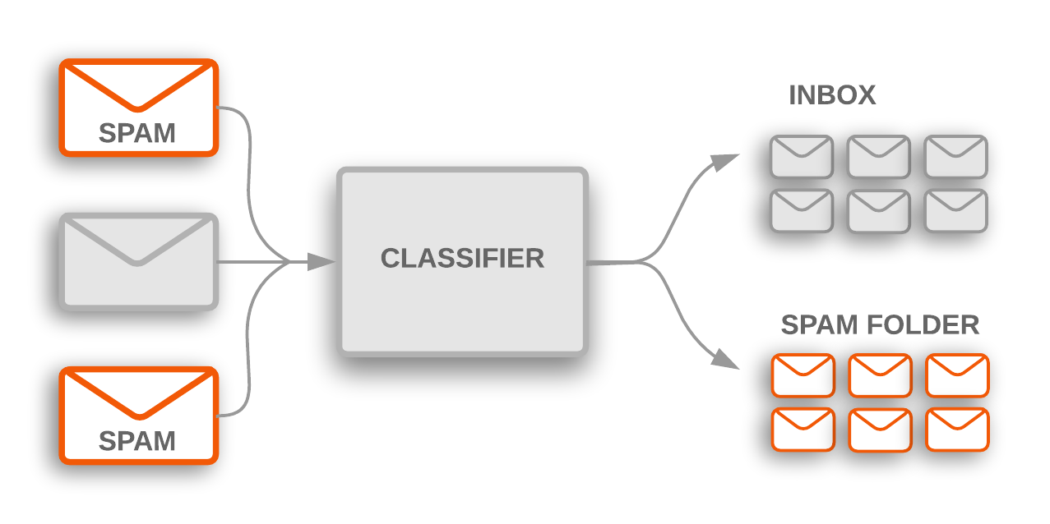
Tasks of Data Mining in Business
Classification – Categorizing data into actionable groups.

Slide 18
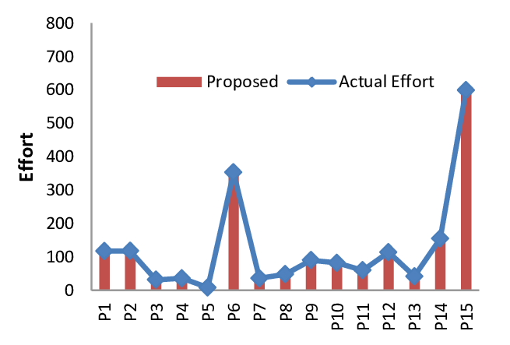
Tasks of Data Mining in Business
Estimation – Response rates, probabilities of responses.

Slide 19

Tasks of Data Mining in Business
Prediction – Predicting customer behavior.

Slide 20
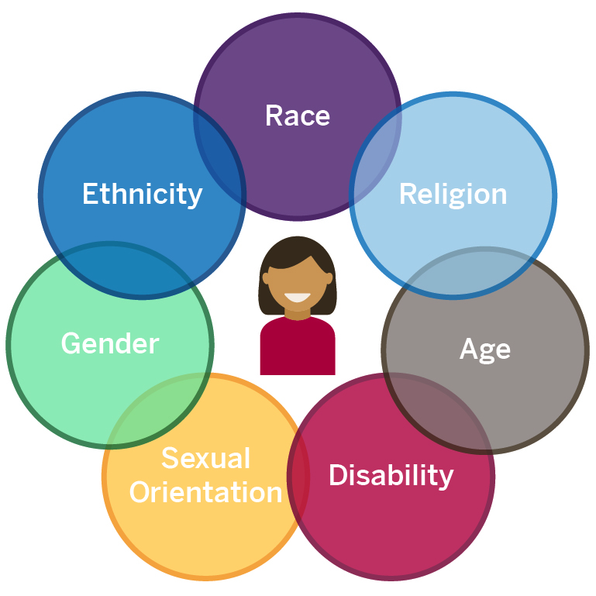
Tasks of Data Mining in Business
Affinity Grouping – What items or services are customers likely to purchase together?

Slide 21

Tasks of Data Mining in Business
Description – Finding interesting patterns.

Slide 22
Data Mining Techniques
Market Basket Analysis
Finding patterns or sequences in the way that people purchase products and services.
Cluster Analysis
Grouping data into like clusters based on specific attributes
Principal Components Analysis (PCA)
Decision Trees and Rule Induction
Logistic / Linear Regressions

Slide 23
Business Intelligence
Collecting and refining information from many sources (internal and external)
Analyzing and presenting the information in useful ways (dashboards, visualizations) So that people can make better decisions
Tools and techniques to turn data into meaningful information.
Process: Methods used by the organization to turn data into knowledge.
Product: Information that allows businesses to make decisions.

Slide 24
BI Initiatives
75% of BI projects fail because of poor communication and not understanding what to ask. (Goodwin, 2010)
65% of BI projects fail because of technology and lack of infrastructure (Lapu, 2007)
70% of senior executives report that analytics will be important for competitive advantage. Only 2% feel that they’ve achieved competitive advantage.

Slide 25
Data Warehouse
A data warehouse is a central repository of information that can be analyzed to make more informed decisions. Data flows into a data warehouse from transactional systems, relational databases, and other sources.
The concept of the data warehouse is a lone scheme that is the repository of all of the organization’s data (or simply data) in a pattern that can be competently analyzed.

Slide 26
Data Warehouse - Challenges
Data should be acquired from a variety of incompatible systems.
The identical piece of data might reside in the databases of distinct systems in distinct types.
A specific data item might not only be represented in distinct formats, which value is the correct one?
Data is continually altering. How often should the Data warehouse be revised to contemplate a sensibly current view?

Slide 27
Data Warehouse - Main Challenge
The amount of data is massive. How is it analyzed and presented easily so that it is useful?
Extract, Transform, and Load (ETL) utilities for the moving of data from the diverse data sources to the common data warehouse.
Data-mining pushes for complex predetermined analysis of the data retained in the data warehouse.
Reporting tools to provide management employees with the outcomes of the analysis in very simple to absorb formats.

Slide 28
Data Warehouse - Strategies
Data mart
The most common approach
Begins with a single mart and architected marts are added over time for more subject areas
Relatively inexpensive and easy to implement
Can be used as a proof of concept (POC) for data warehousing
Can postpone difficult decisions and activities
Requires an overall integration plan

Slide 29
Data Warehouse - Strategies
Enterprise-wide
A comprehensive warehouse is built initially
An initial dependent data mart is built using a subset of the data in the warehouse
Additional data marts are built using subsets of the data in the warehouse
Expensive, time consuming, and prone to failure
When successful, it results in an integrated, scalable warehouse

Slide 30
ETL – Extract, Transform, Load
Extracts data from one or more data-sources
Transforms it and cleanses it to be optimized for reporting and analysis
Loads it into a data store or data warehouse
There are many different models of ETL tools in today’s BI market, from complex, specialized products to light, web-based solutions that work easily with multiple data sources.

Slide 31
Reasons for “Dirty” Data
Dummy values
Absence of data
Multipurpose fields
Cryptic data
Contradicting data
Violation of business rules
Reused primary keys
Non-unique identifiers (keys)
Data integration problems

Slide 32
Data Cleaning
Parsing - locates and identifies individual data elements in the source files and then isolates these data elements in the target files.
Parsing the first, middle, and last name; street number and street name.
Correcting -corrects parsed individual data components using sophisticated data algorithms and secondary data sources.
Replacing a vanity address and adding a zip code.

Slide 33
Data Cleaning
Standardizing - standardizing applies conversion routines to transform data into its preferred (and consistent) format using both standard and custom business rules.
Adding a pre name
Replacing a nickname

Slide 34
Data Cleaning
Matching - searching and matching records within and across the parsed, corrected and standardized data based on predefined business rules to eliminate duplications.
Identifying similar names and addresses.
Consolidating - analyzing and identifying relationships between matched records and consolidating/merging them into ONE representation.

Slide 35
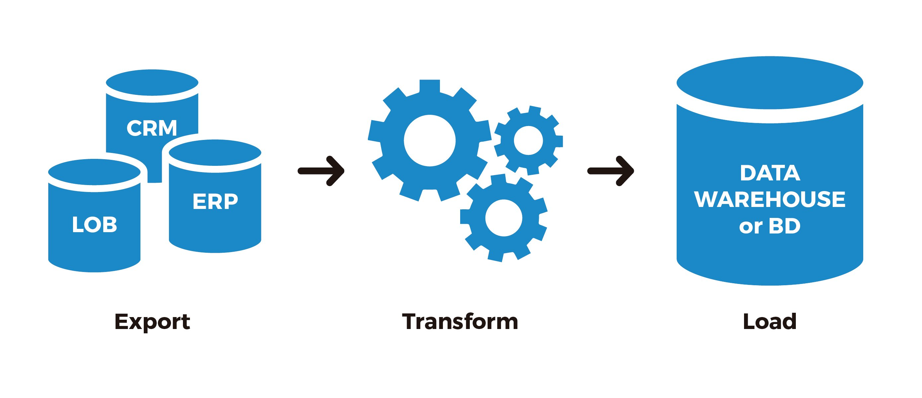
Data Transformation and Loading
Transforms the data with business rules and standards that have been established
format changes, deduplication, splitting up fields, replacement of codes, and aggregates
Data are physically moved to the data warehouse

Slide 36
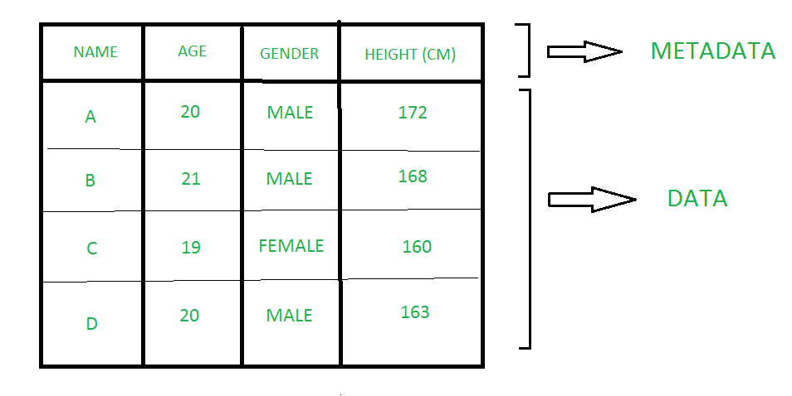
META Data
Data about data, includes data sources and targets, database, table and column names.
Needed by both information technology and users
Users need to know entity/attribute definitions
Reports/query tools
Report distribution information

Slide 37
Mathematical Models
Mathematics can be used to represent real-world situations.
The instruments used to represent real are called mathematical models.
They help us understand how the real-world works.
A simple mathematical model representing profit calculation is illustrated as
Revenues
Substract
Profit
Costs

Slide 38
Use of Mathematical Models in Business
Decision Making
Multiple participants with conflicting views
Use input variables and a set of conditions to arrive at a decision
Decide whether to invest in a project or not

Slide 39
Use of Mathematical Models in Business
Making predictions
Requirement of predicting certain factors, such as revenue, growth rate, costs.
Used in case of new product launch, change in strategy, investment needs, etc.
Predictive mathematical models are used that analyze historical data and use probability distribution as input for predicting the future values.
Regression analysis

Slide 40
Use of Mathematical Models in Business
Optimizing
These models often maximize or minimize a quantity by making changes in another variable or a set of variables.
What should I do to maximize the profit?
Revenues
Substract
Profit
Costs

Slide 41
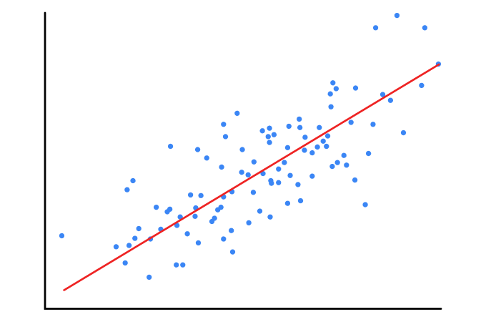
Transforming Data into Decisions
Define objectives and information needs
Collect data
Analyze data
Present information
Make data-driven decisions

Slide 42


Connection to Data
Internet connection to on-prem data assets or Cloud assets
SQL Server Management Studio
Stored procedures
Stored procedures
Excel Pivot tables and Pivot Charts

Slide 43


Connection to Data
Internet connection to on-prem data assets or Cloud assets
.NET
SQL Server Management Studio
Stored procedures
Visual Studio using VB language
And stored procedures

Slide 44

Connection to Data
Internet connection to on-premises data assets or Cloud assets
SQL Server Management Studio
Stored procedures
Stored procedures
Reports, dashboards, story boards

Slide 45

Connection to Data
Internet connection to on-prem data assets or Cloud assets
SQL Server Management Studio
Stored procedures
Stored procedures

Slide 46
Why so many IT approaches?
The more technologies you are familiar with the more you understand the overall BI Architecture picture and can lead a project
A mastery over technical tools fuels your ability to be a competent analyst
The more tools you have under your belt, the more likely you will NOT get an entry-level BI or analyst position (rather rise in stature)

Slide 47
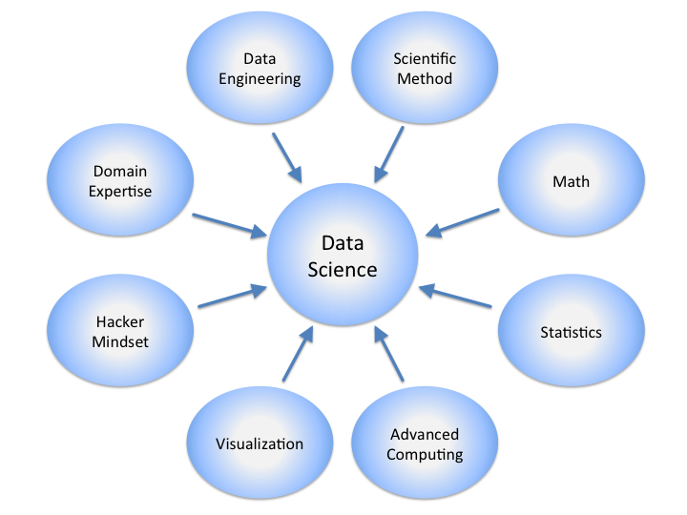
Will I become a Data Scientist?
Wikipedia.com

Slide 48
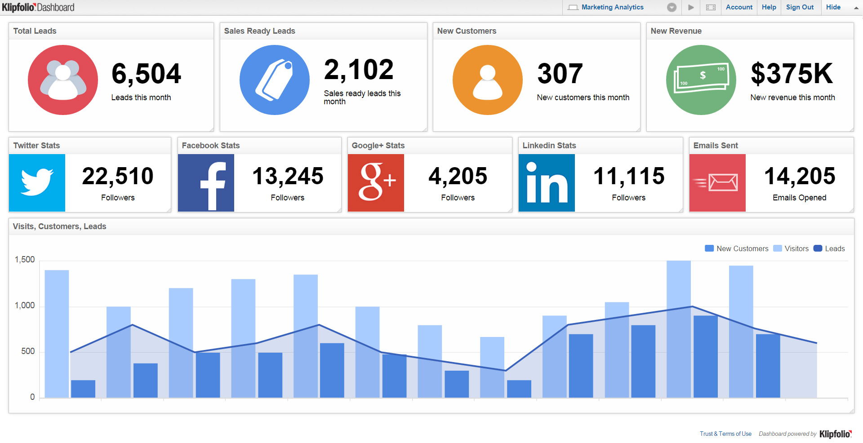
Reporting Tools
The knowledge created by a data-mining engine is not very useful unless it is presented easily and clearly to those who need it. There are many formats for reporting information and knowledge results. One of the common techniques for displaying information is the digital dashboard.

Slide 49
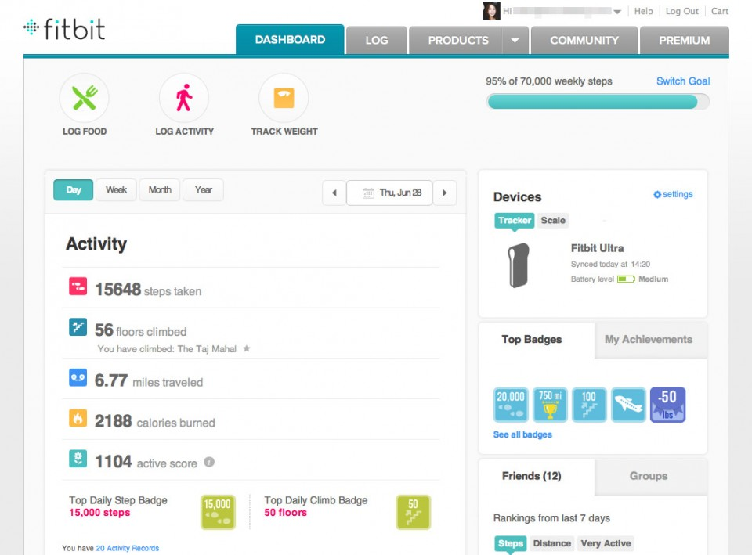
The business / customers should find the answers to their questions in the dashboard
Reporting Tools

Slide 50
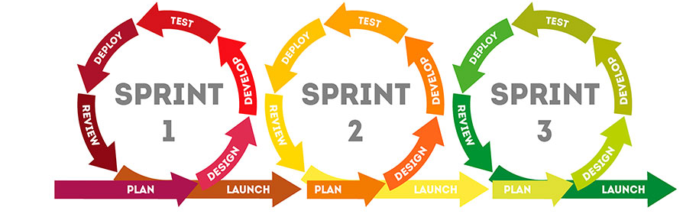
Support Agile Methodology
The Agile methodology is a way to manage a project by breaking it up into several phases.
It involves constant collaboration and continuous improvement at every stage.
Teams cycle through a process of planning, executing, and evaluating.
Continuous collaboration is vital.

Slide 51
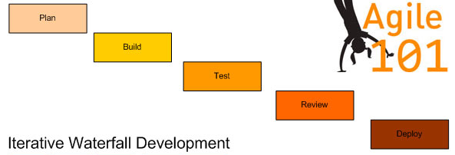
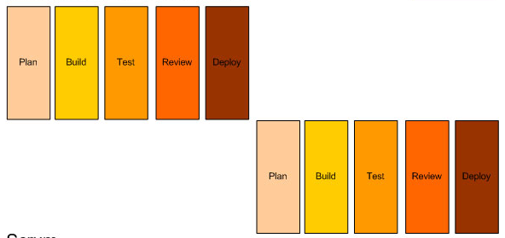
The Basics: From Traditional to Agile
Waterfall model
Iterative model
Notes:
It is all in how you slice it…

Slide 52
Agile Principles
Our highest priority is to satisfy the customer.
Welcome changing requirements, even late in development.
Deliver working software frequently, from a couple of weeks to a couple of months (with a preference to the shorter timescale).
The most efficient and effective method of conveying information to and within a development team is face-to-face conversation.

Slide 53
Agile Principles
Business people and developers must work together daily throughout the project.
At each stage/sprint, you are holding a deliverable project!
Working software is the primary measure of progress.
The sponsors, developers, and users should be able to maintain a constant working.
The best architectures, requirements, and designs emerge from self-organizing teams.

Slide 54
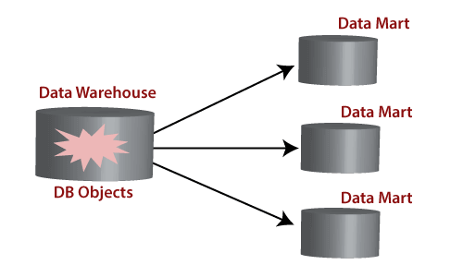
Data Mart and Data Sources
A data mart is a structure / access pattern specific to data warehouse environments.
Used to retrieve client-facing data.
Data sources gather and integrate the data stored
May include unstructured documents (such as data received from external providers)

Slide 55
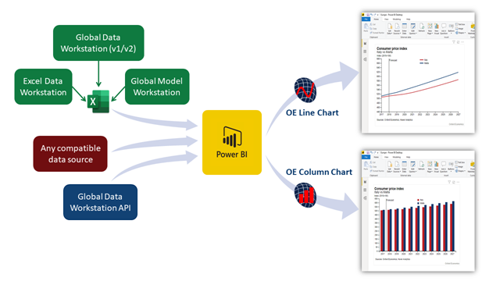
Data Mart and Data Sources

Slide 56
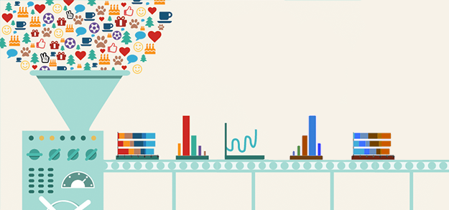
Data Driven Project
When a company employs a “data-driven” approach, it means it makes strategic decisions based on data analysis and interpretation.
A data-driven approach enables companies to examine and organize their data with the goal of better serving their customers and consumers.

Slide 57
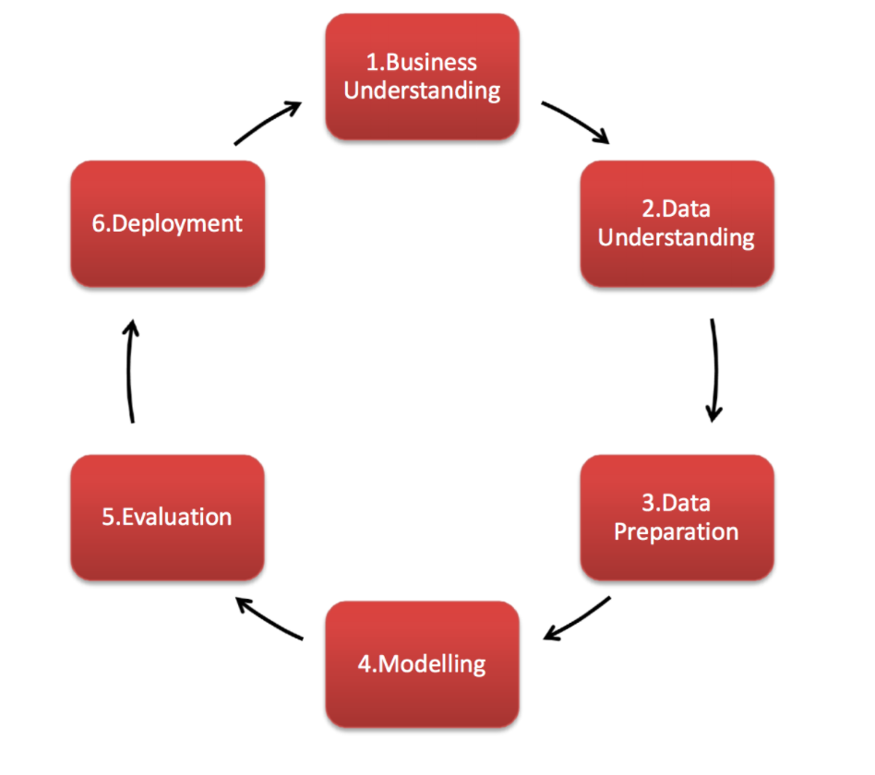
CRISP-DM
Cross-Industry Standard Process for Data Mining, known as CRISP-DM, is a model that describes common approaches used by data mining experts. It is the most widely-used analytics model. CRISP breaks the process of data mining into six major phases.

Slide 58
POC

Slide 59
Proof Of Concept
Proof of concept (POC), also known as proof of principle, is a realization of a certain method or idea in order to demonstrate its feasibility or a demonstration in principle with the aim of verifying that some concept or theory has practical potential.
A proof of concept is usually small and may or may not be complete.
Test feasibility of business concepts and proposals to solve business problems and accelerate business innovation goals

Slide 60
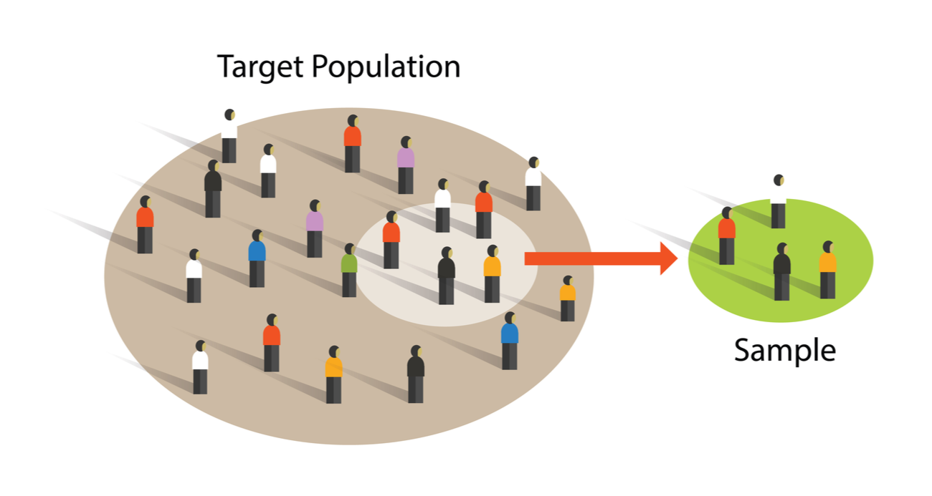
Tips for Successful POC
A POC that doesn’t use your own data, doesn’t prove anything
Limit the scope of data sources involved
Trimming the data down
Using sample data sets instead of your own data

Slide 61
Tips for Successful POC
Do not get distracted by pretty visuals
With visualization software components a dime a dozen, a vendor can easily ‘fake’ these pretty graphics.
Address future and present requirements
it doesn't matter who you are or how much experience you have – it is almost impossible to know in advance what your future requirements will be.
BI requirements tend to be highly dynamic because businesses change all the time and business users are continually refining and adjusting their requirements.

Slide 62
Tips for Successful POC
Consult your own IT professionals, even if they are not directly involved
In many organizations business analytics solutions are already set up that are highly reliant on IT. Business professionals that are not being able to extract relevant data quickly and independently, will look for BI solutions that cut IT completely out of the loop.
A POC should not require you to make a financial investment
Demand one solid report or dashboard running over your own data before you agree to any financial commitment.

Slide 63
Mockup

Slide 64
Mockup
Mockup is a scale or full-size model of a design or device, used for teaching, demonstration, design evaluation, promotion, and other purposes.
A mockup may be a prototype if it provides at least part of the functionality of a system and enables testing of a design.
Mock-ups are used by designers mainly to acquire feedback from users.

Slide 65
Optimizing Queries in SQL

Slide 66
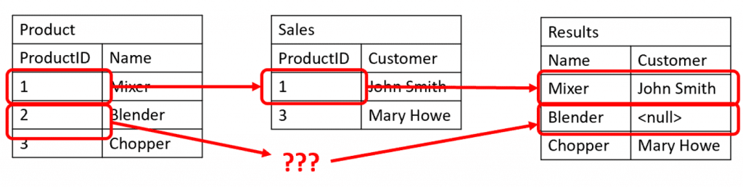
Merge Multiple Sources
- Merge different data sources by key
- Can be applied by JOIN or SubQueries

Slide 67
JOIN vs SubQueries
Use both Joins and subqueries to query data from different tables.
Though they may even share the same query plan, are many differences between them.
Knowing the differences and when to use either a join or subquery to search data from one or more tables is key to mastering SQL.

Slide 68
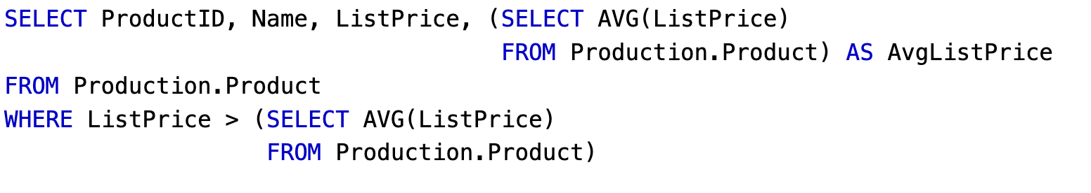
Subquery
A common use for a subquery may be to calculate a summary value for use in a query. Notice how the subqueries are queries unto themselves.

Slide 69
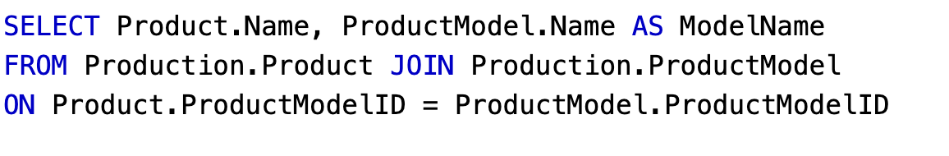
JOIN
Combine rows from one or more tables based on a match condition.
Types: left, right, full, inner

Slide 70
JOIN vs SubQueries
The subquery returns a single result, which then filters the records.
The join is an integral part of the select statement.
Join can not stand on its own as a subquery can.
Joins are used (mostly) in the FROM clause
Subquries can appear anywhere

Slide 71
Advantages of JOIN
Executes faster than subquery (running time). The retrieval time of the query using joins almost always will be faster than that of a subquery.
Can maximize the calculations on the database.
For example, instead of multiple queries using one join query.
Have many types of joins.

Slide 72
Disadvantages of JOIN
Not easy to read as subqueries.
More joins in a query means the database server has to do more work
Can be confusing which join is the appropriate type of join to use to yield the correct desired result set.
Joins cannot be avoided when retrieving data from a normalized database

Slide 73
Advantages of SubQuery
Divide the complex query into isolated parts so that a complex query can be broken down into a series of logical steps.
Easy to understand and maintenance the code.
Subqueries allow you to use the results of another query in the outer query.
In some cases, subqueries can replace complex joins and unions.

Slide 74
Disadvantages of SubQuery
The optimizer is more mature for MYSQL for joins than for subqueries.
A subquery can be executed more efficiently if you rewrite it as join.
Can not modify a table and select from the same table within a subquery in the same SQL statement.

